Slide 1



Process for uploading Investments proofs on the online tool for FY 2011-12
Payroll Team
SAP Labs India
January 2012

Slide 2
Features of online tool :
  The on-line tool will help you to update your proposed Investment plan and actual investment proof submission for the Financial Year 2011-2012
  You need to upload the Actual Investment Proofs after updating in the system by using the Link.
  Medical ,Telephone and LTA bills needs to be submitted along with the claim form as and when the employee incurs the expenditure after updating the link
  Rent receipts needs to be submitted in hard copy
  It also help you to know the current status of your claims on-line (i.e. whether its under process or accepted or rejected for clarification, etc)

Slide 3
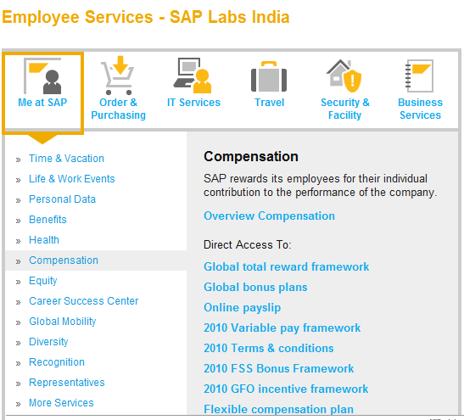
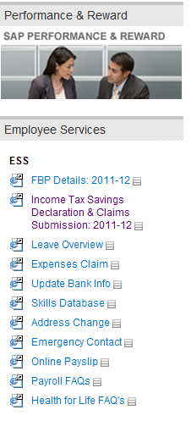
How to Access the Link?
First level
  Second level
    Third level

Slide 4
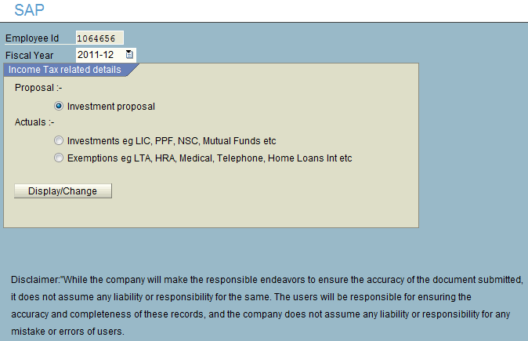
Submission of actual investment proof/s
Step 1
Click on the Investment actuals.
Step 2
Click on Display / Change Button
(this will take you to next step)

Slide 5
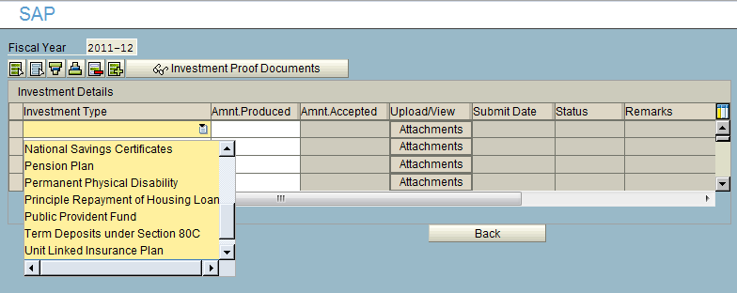
Documents Submitting Process :
Step 4 :
Enter the correct amount
Step 3 :
Select the type of investment under
which you would like to upload
Step 5 :
Click on the attachments for uploading

Slide 6
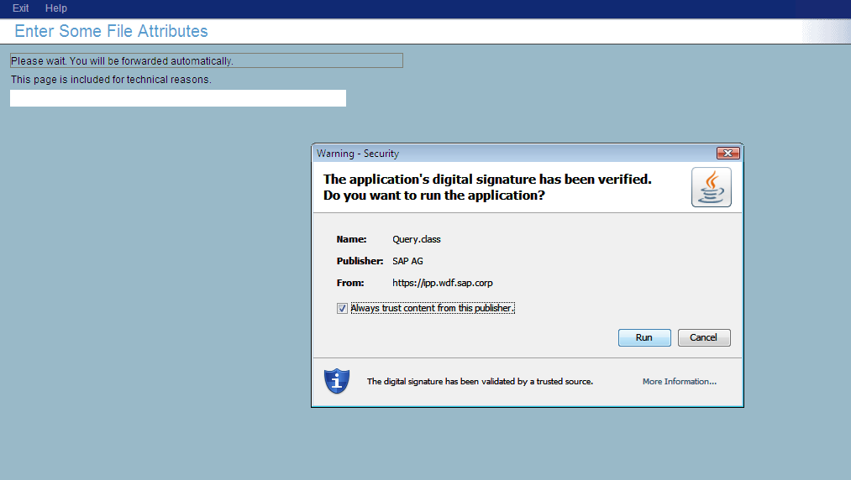
Documents Submitting Process :
First level
  Second level
    Third level
Step 6 :
Click on run button to enable the application only for the first time

Slide 7
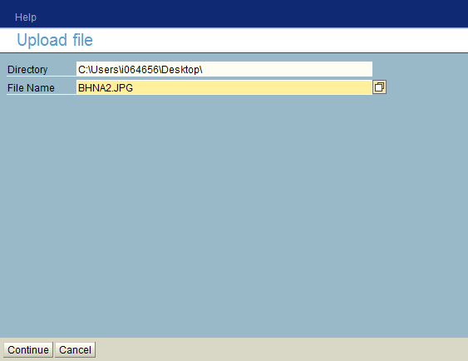
Documents Submitting Process :
Step 7 :
Select the file from the location you have saved and click Save
Note: Scan and save the related document on your Desktop
Step 8 :
Click on Continue

Slide 8
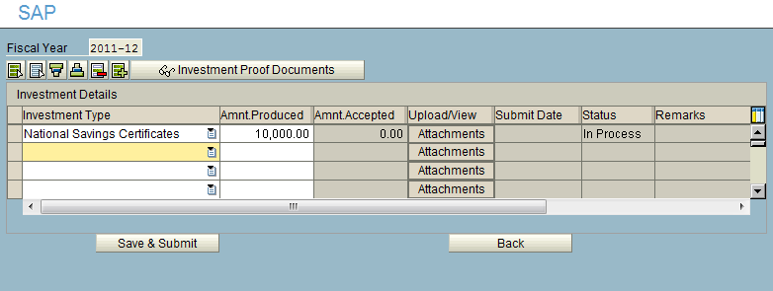
Documents Submitting Process :
NOTE :
If you have 2 or 3 documents for the same investment type ,copy the documents in one folder and upload as one attachment.
Step 9 :
After uploading the investment proofs, click on “Save & Submit.”
NOTE :
Amount Produced must be equal to the proof attached against the same line

Slide 9
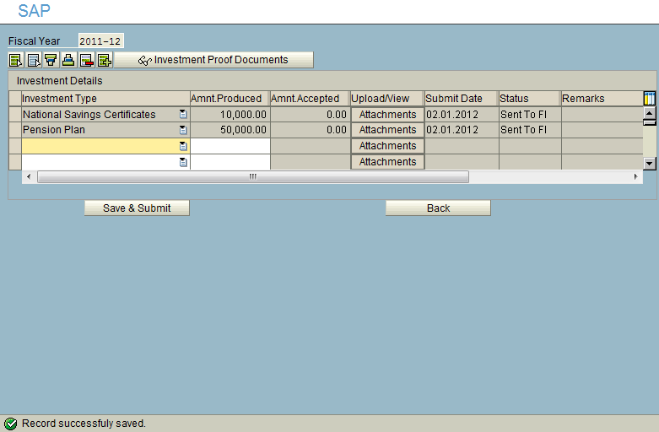
Verify the Submission of Proofs :
Step 10 :
Check the status, must be “Sent to FI”
Step 11 :
Finally you must get a message for saving the documents.

Slide 10
Submitting Rent, LTA, Telephone, Medical Bills and Home Loan Interest Proofs :
Step 1 :
= Click On Exemptions,
= Click on Display / Change Button

Slide 11
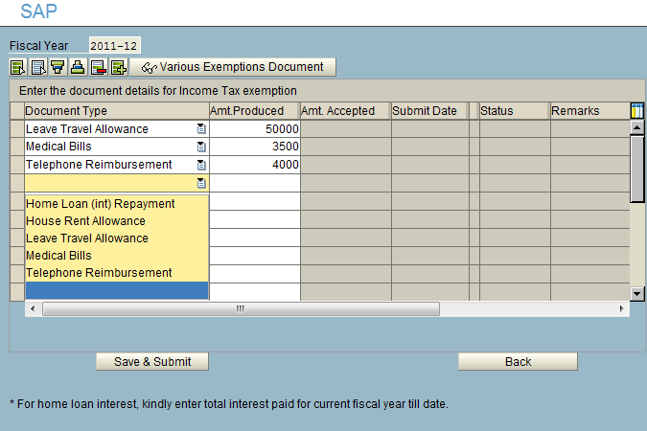
Submitting Rent, LTA, Telephone, Medical Bills and Home Loan Interest Proofs :
Step 2 :
Select the document type, Update the amount, Click Save & Submit, Check the status, must be “Sent to FI”

Slide 12
Thank You!
For assistance : e-mail to
LabsIndia.payroll@sap.com

